Slide 1
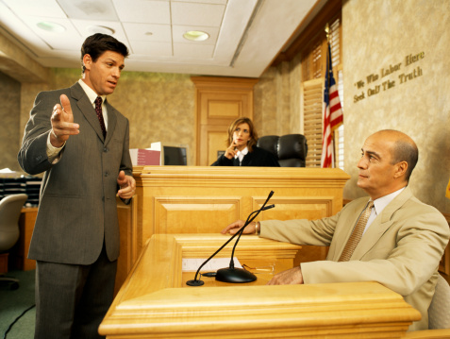
How to direct examine
Rules and Technique

Slide 2
Rule #1
(Attorney) “For the record, please state your name and where you live”
Means that you are verifying we have the correct witness testifying

Slide 3
Rule #2
Go through some background questions
Ex) Tell me about yourself, what do you do, do you know _____ (Plaintiff/Defendant), how do you know _______
In other words, get them “Connected” to the case in a clear way

Slide 4
Rule #3
“After” going through the background, get the person connected to the case in question
In other words, were they a part of the case and how

Slide 5
Rule #4
Focus on what the witness saw (Witnesses can testify to anything they saw connected to the case and some of what they heard)
If its not connected to the case, its “Irrelevant”
And you CANNOT repeat a question

Slide 6
Rule #5
Eliminate (Or strongly limit) pronouns
He, she, it
Call people by their names, titles, etc…

Slide 7
Rule #6
Be respectful
Call people Mr./Mrs, not by their first name if possible
Plaintiff, call the defendant “That defendant”
Defense, call the defendant “Mr/Mrs”

Slide 8
Rule #7
ALL questions must NOT be leading
Start every questions with Who, What, Where, When, Why, How or explain/describe
BUT, you can put the witnesses last answer into a follow-up question
Ex) “You just said the bank robber pulled out driving a Ford Bronco, why do you believe this?”

Slide 9
Rule #8
TELL A STORY
In other words, be descriptive as you can by telling the story in a chronological order, of the events as they took place
Not always in order within the witness statement

Slide 10
Rule #9
In a real world, there are no time limits, but for this assignment, you cannot have a direct examination less than 2 and a ½ minutes or more than 3 and ½ minutes.
So, GET TO THE STORY as quick as you can
(Relevance)- Part of the rule is based on wasting the courts time, so focus on things connected to the case

Slide 11
Rule #10
Each team will decide who will play the role of the attorney and which the witness
When you are done, “I” will cross examine the witness to introduce you to cross examination
DO NOT ASK how many questions you need to ask, focus on the timing
Witnesses need to know their statements and each answer

Slide 12
QUESTIONS??
You will have approximately 6 classes to prepare
Presentations will be like first ones (Bullpen)
Anything else?

